Slide 1


Power Query Table Functions Part 7

Slide 2
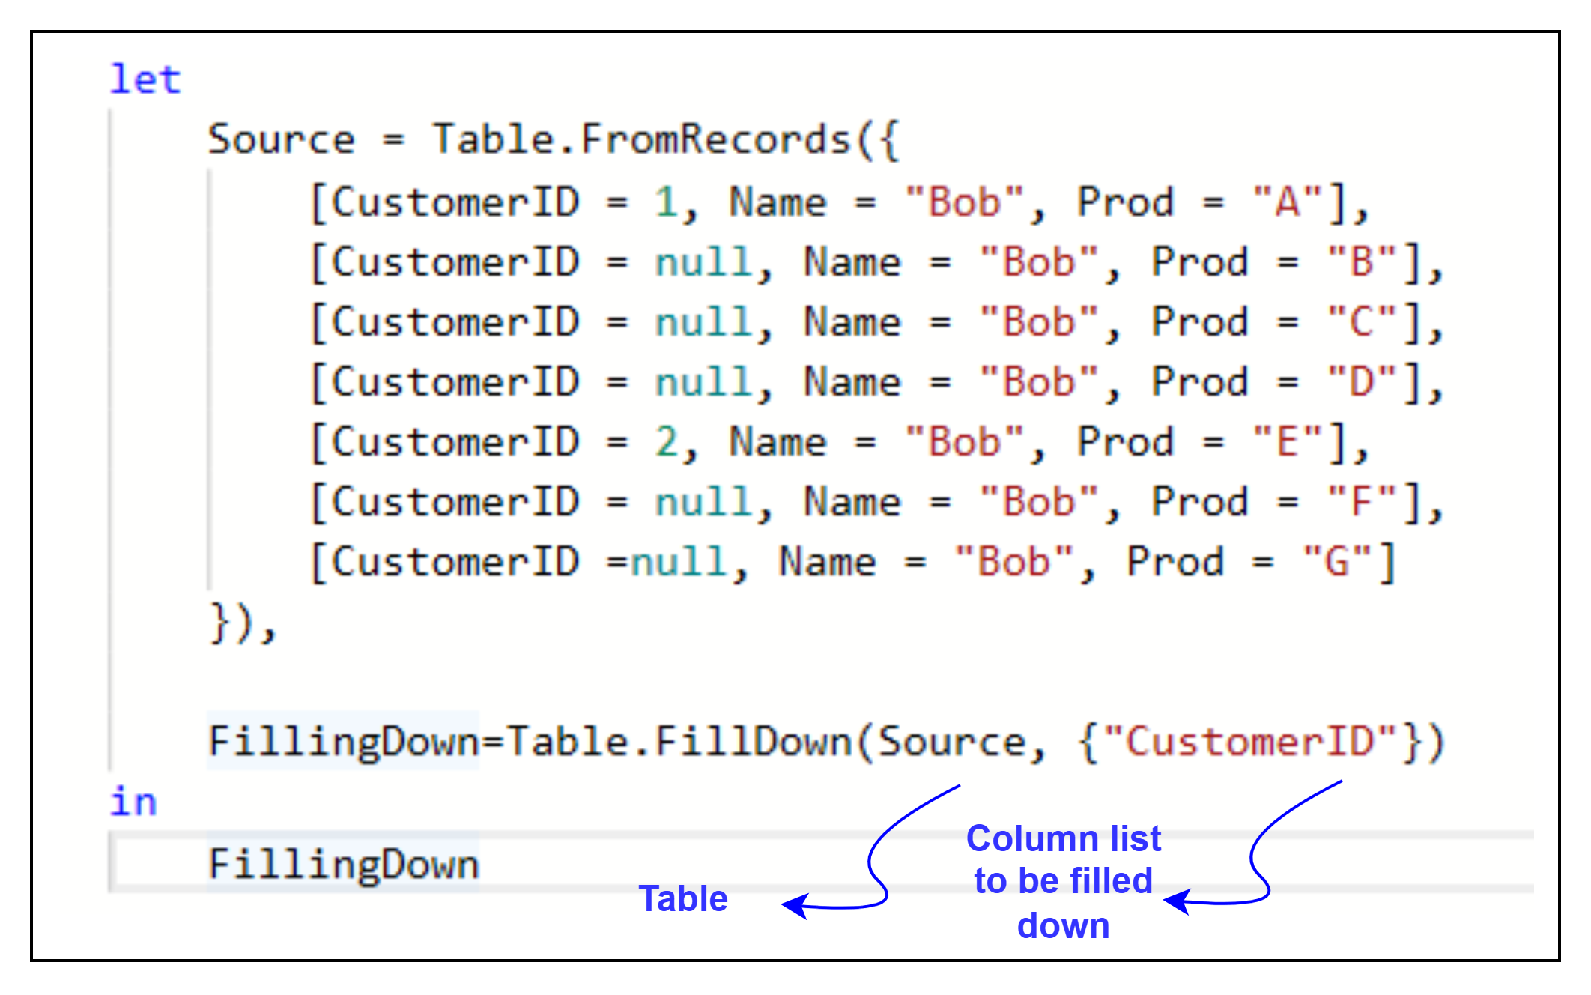
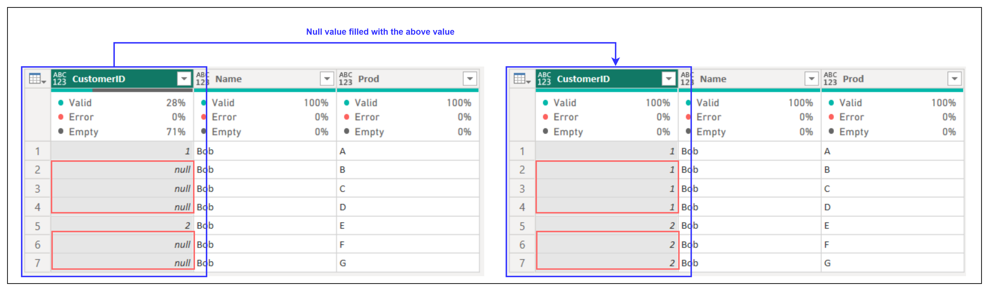
1. Table.FillDown
Description: Fills null values in a column with the value above.
Example:
Result:
Use Cases:
Filling missing values with the most recent value in grouped data.
Preparing hierarchical data for analysis.

Slide 3
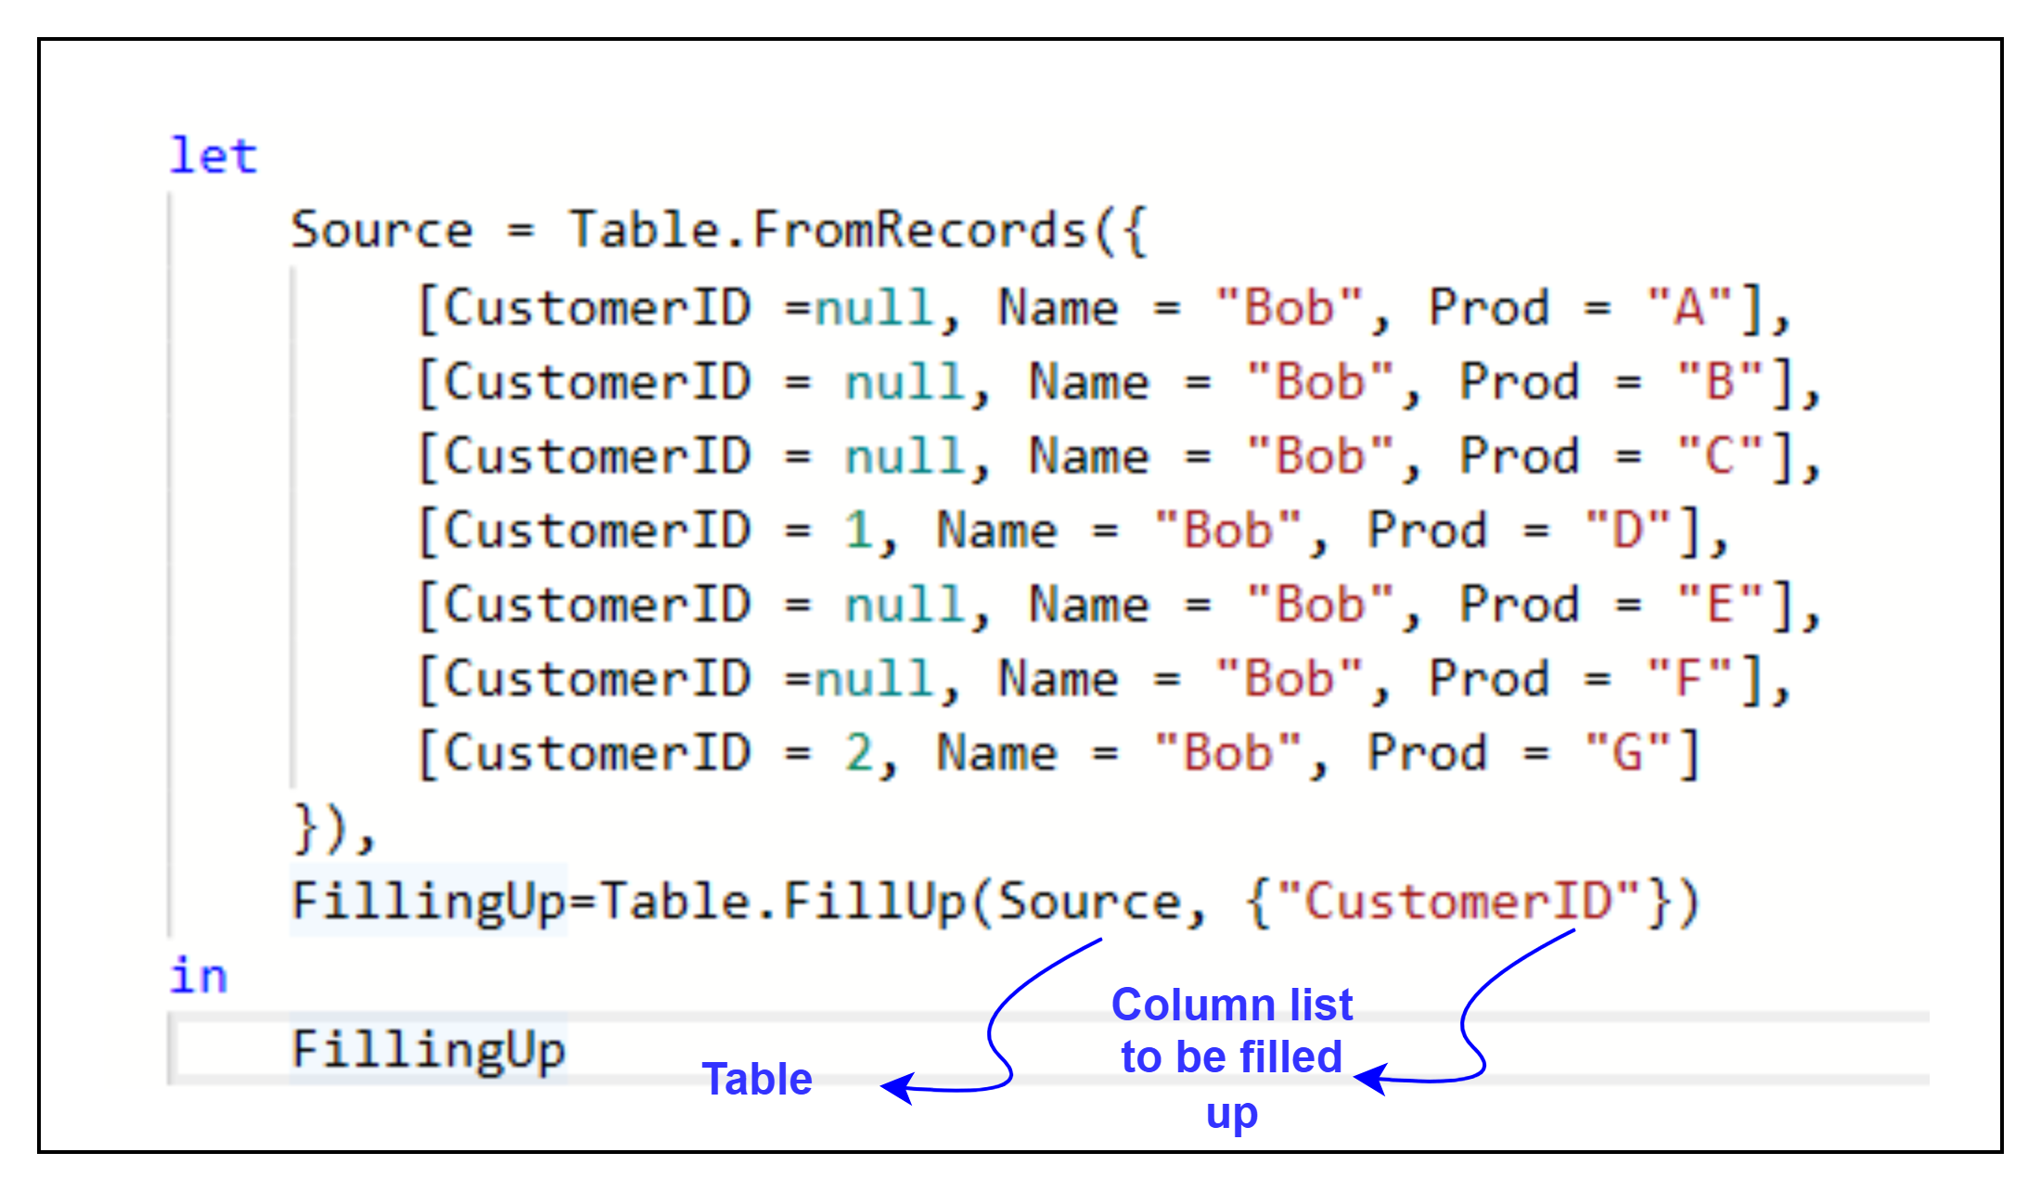
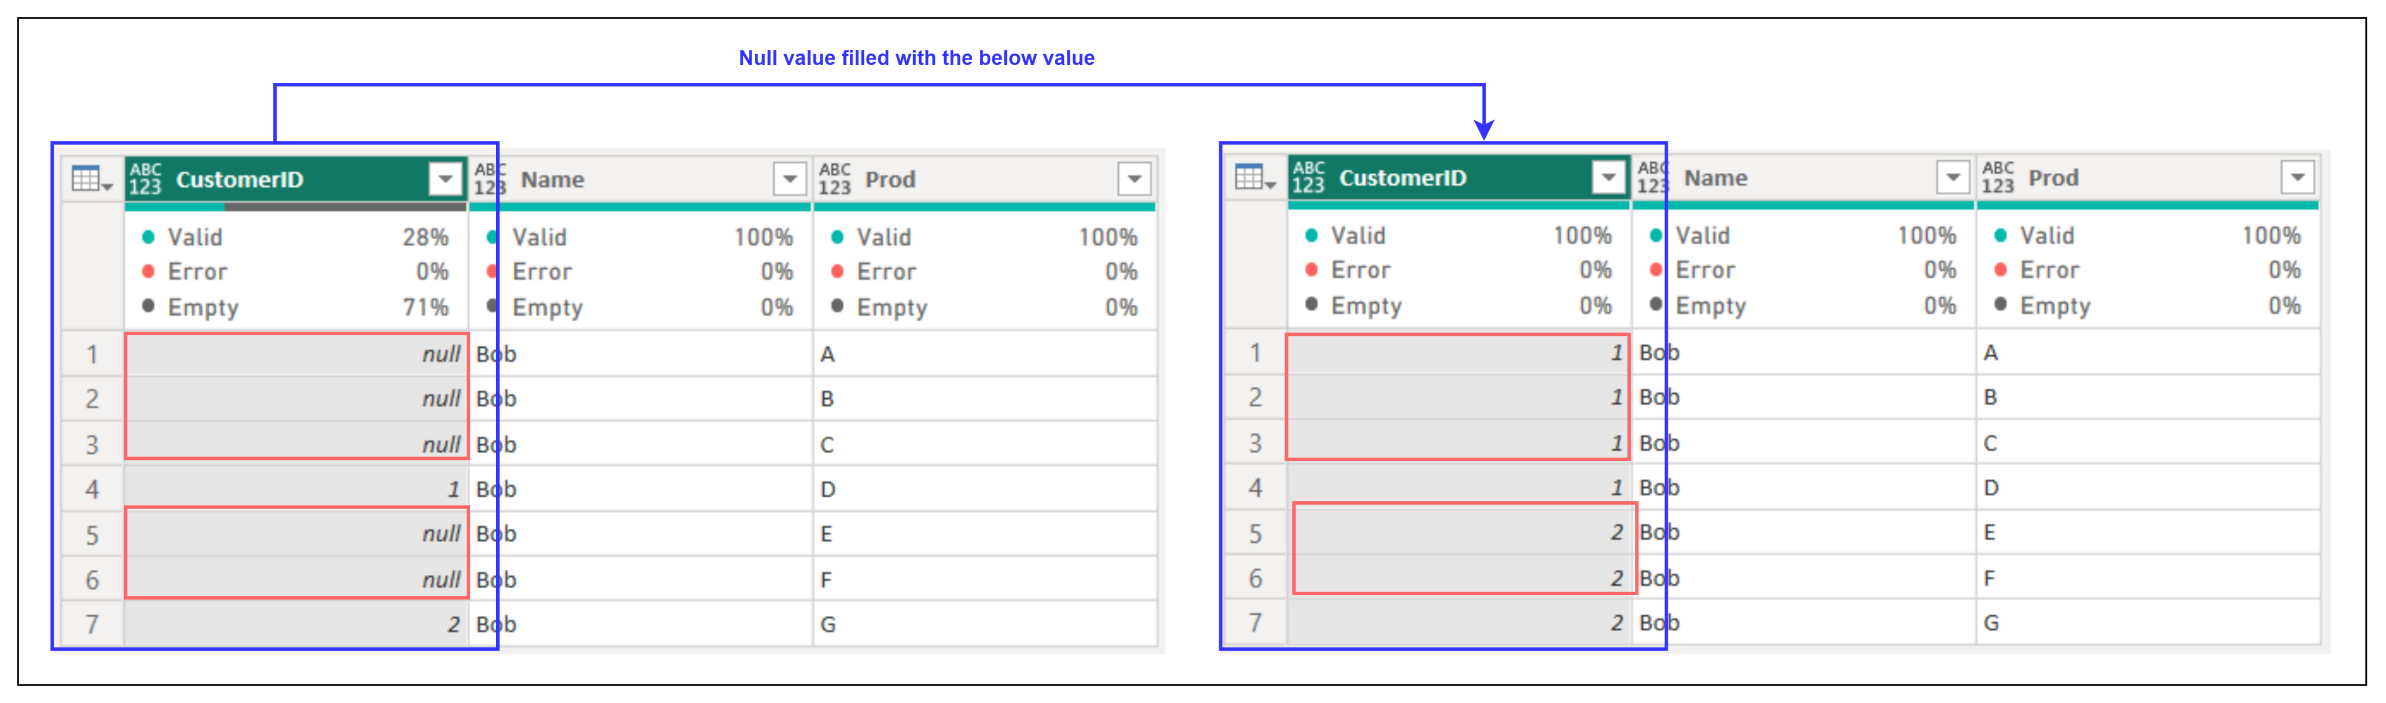
2. Table. FillUp
Description: Fills null values in a column with the value below.
Example:
Result:
Use Cases:
Filling missing values for chronological or hierarchical data.
Preprocessing data for calculations.

Slide 4
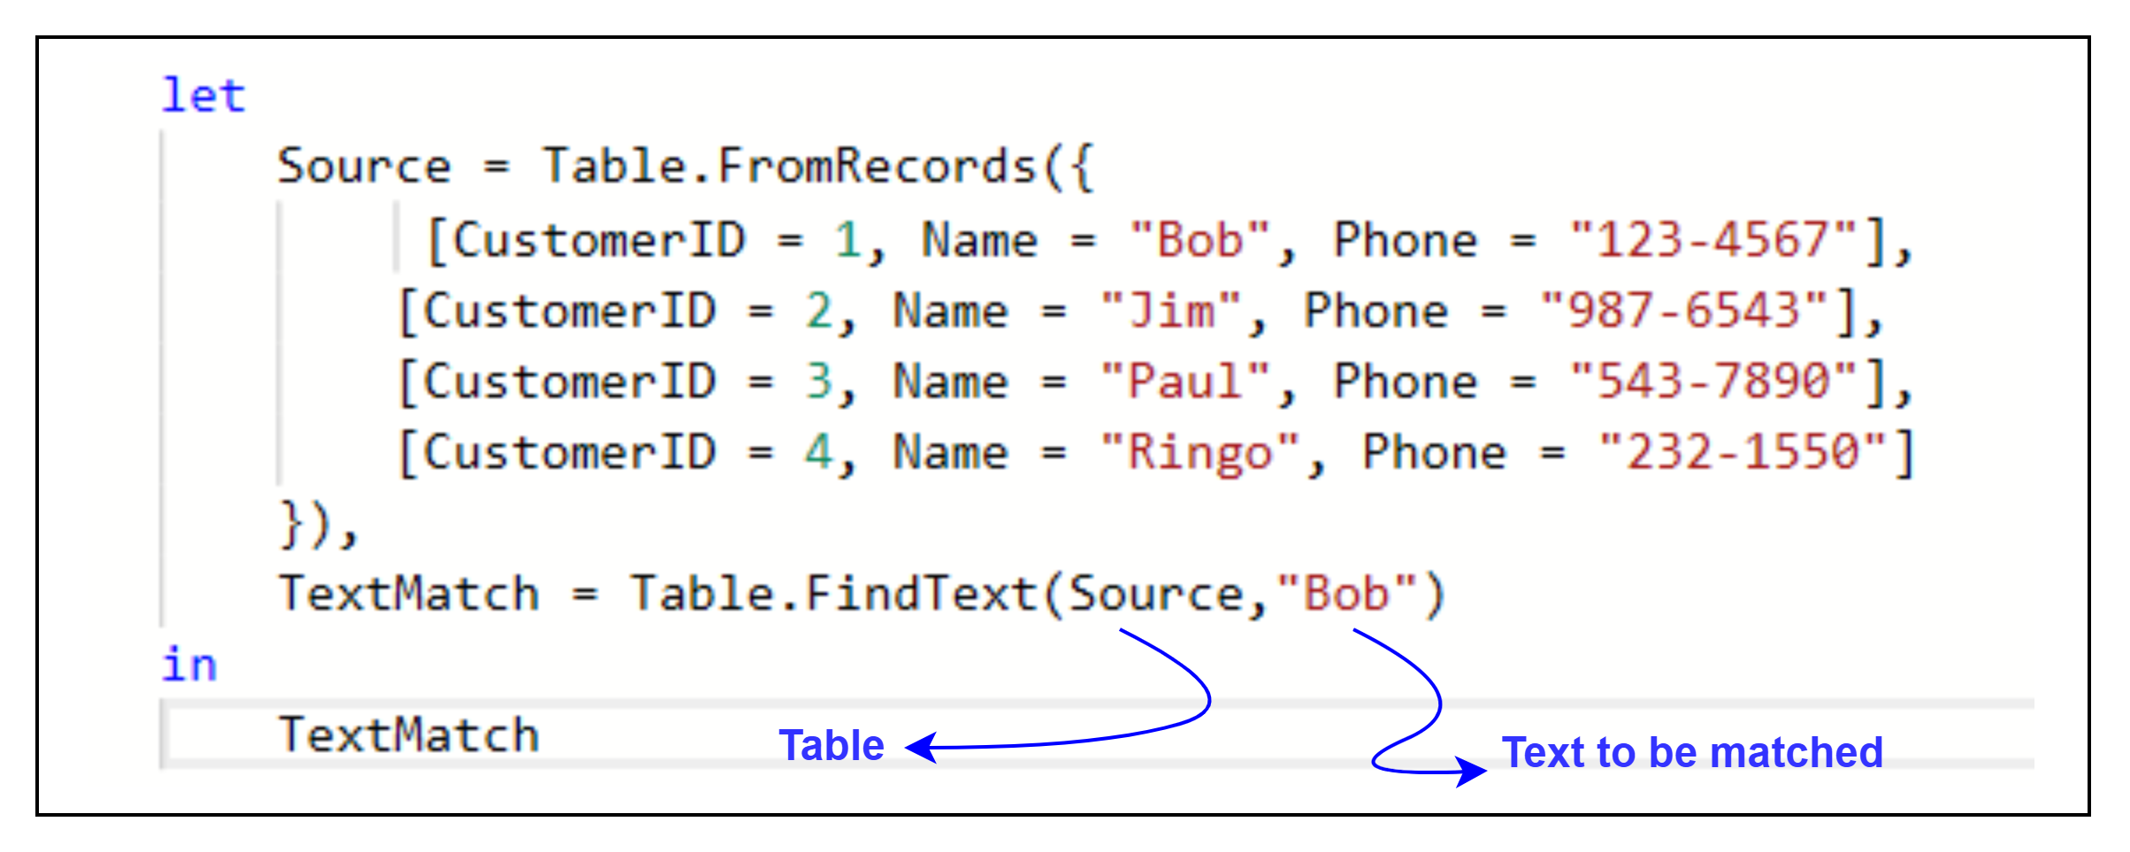
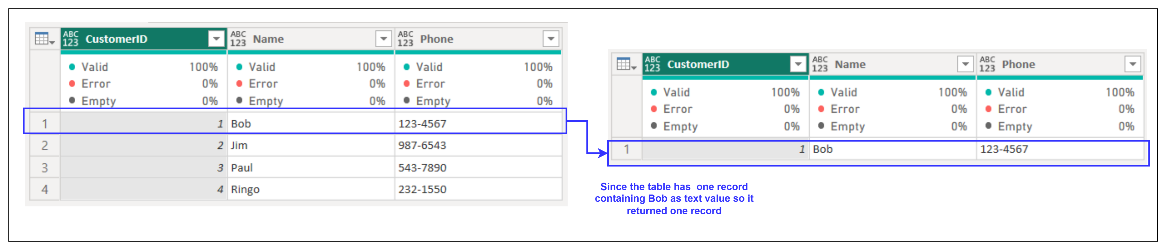
3. Table.FindText
Description: Returns rows containing the specified text in any column.
Example:
Result:
Use Cases:
Searching for specific substrings in a dataset.
Filtering data for textual analysis or validation.

Slide 5
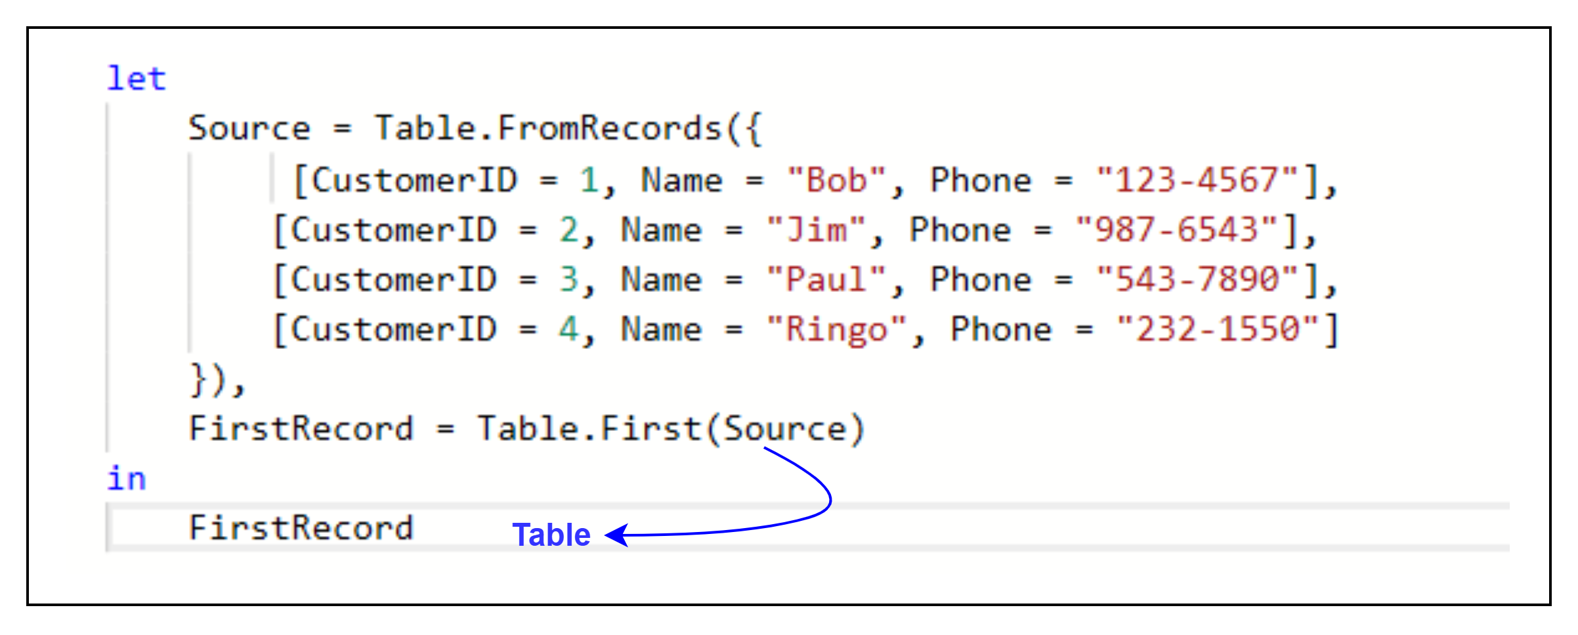
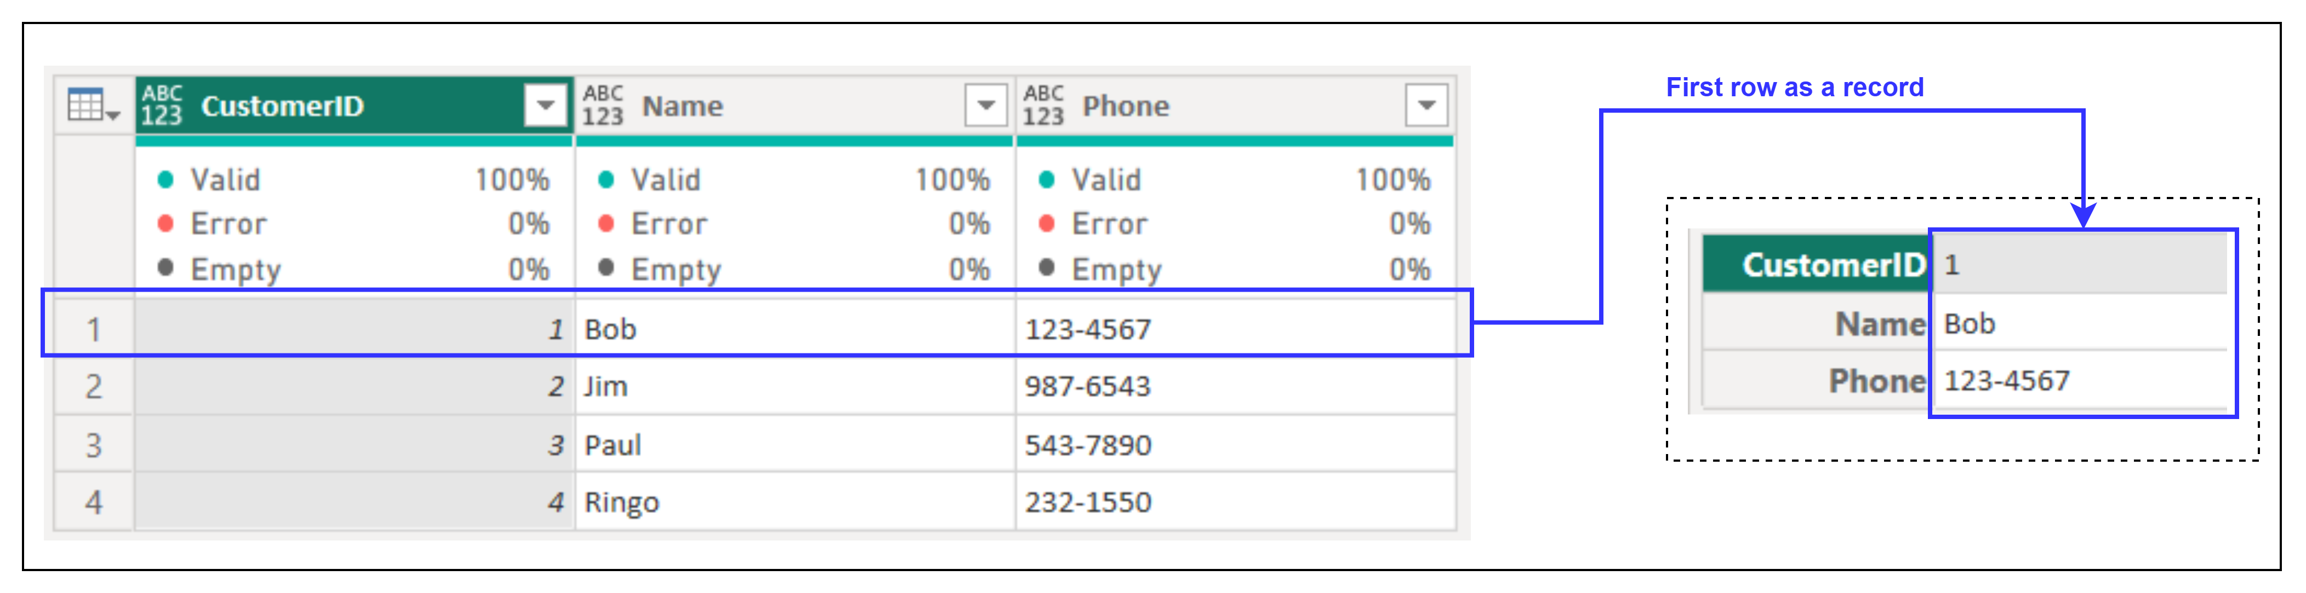
4. Table.First
Description: Returns the first row of a table.
Example:
Result:
Use Cases:
Extracting the first record for preview or validation.
Accessing the starting value of a dataset.

